Slide 1
Data Analytics Using R
T-20 World-Cup 2016 Matches Prediction
Dnyanesh Kolapkar 2013BIT033
Pradnya Gosavi 2013BIT054
Aishwarya Wagaskar 2014BIT207
Guide – Prof . U. B. Chavan.

Slide 2
Introduction
What is Big Data?
What is R?
What is Data Analytics?

Slide 3
Objectives
To learn R.
To study Data Analytics.
To study R Studio.

Slide 4
T-20 WorldCup 2016
16 Teams.
2 Groups.
21 Matches.

Slide 5
Prediction using
data analytics
Cricket data sets.
Decision Trees.

Slide 6
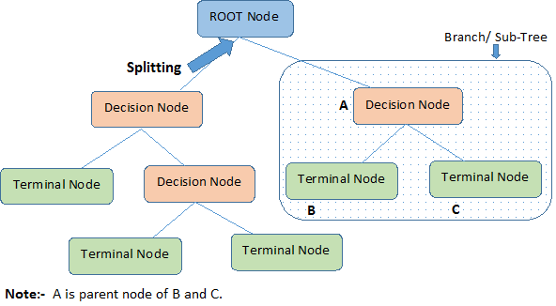

Slide 7
